Slide 1

Liverpool Nights Out
Your nights
Made simple
https://17001172.wixsite.com/liverpool

Slide 2

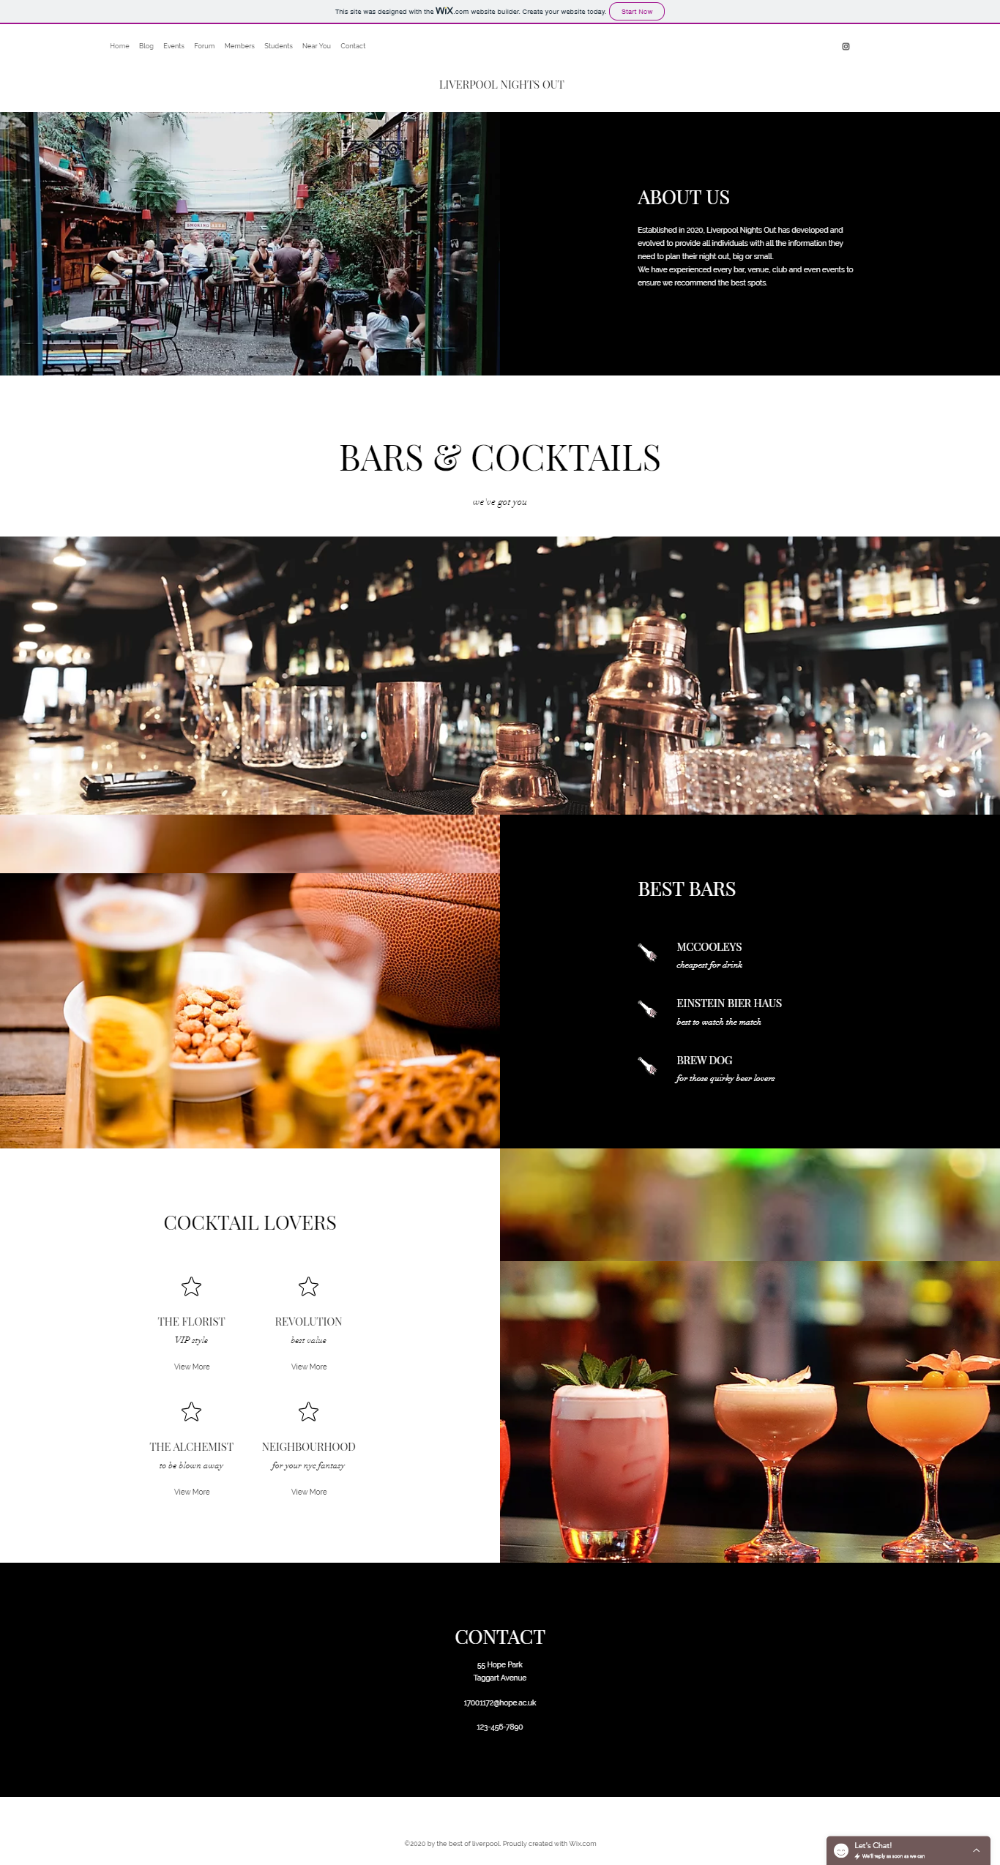
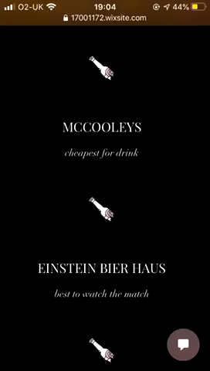
Home
Features
About us
Best bars
Cocktail lovers
Contact Us info
Chat
Social media
additional

Slide 3
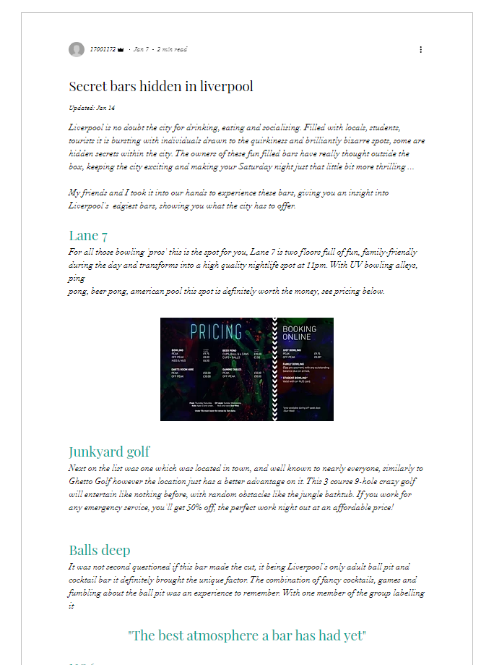
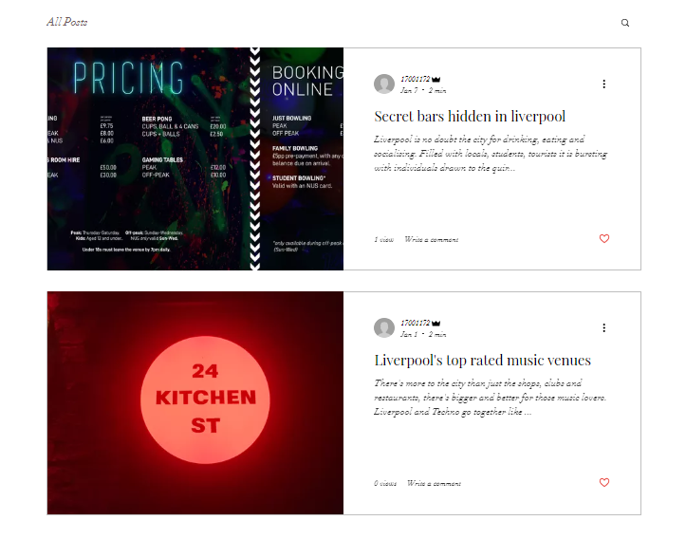
Blogs
Features
Blog posts
read / comment / like
https://17001172.wixsite.com/liverpool/blog

Slide 4
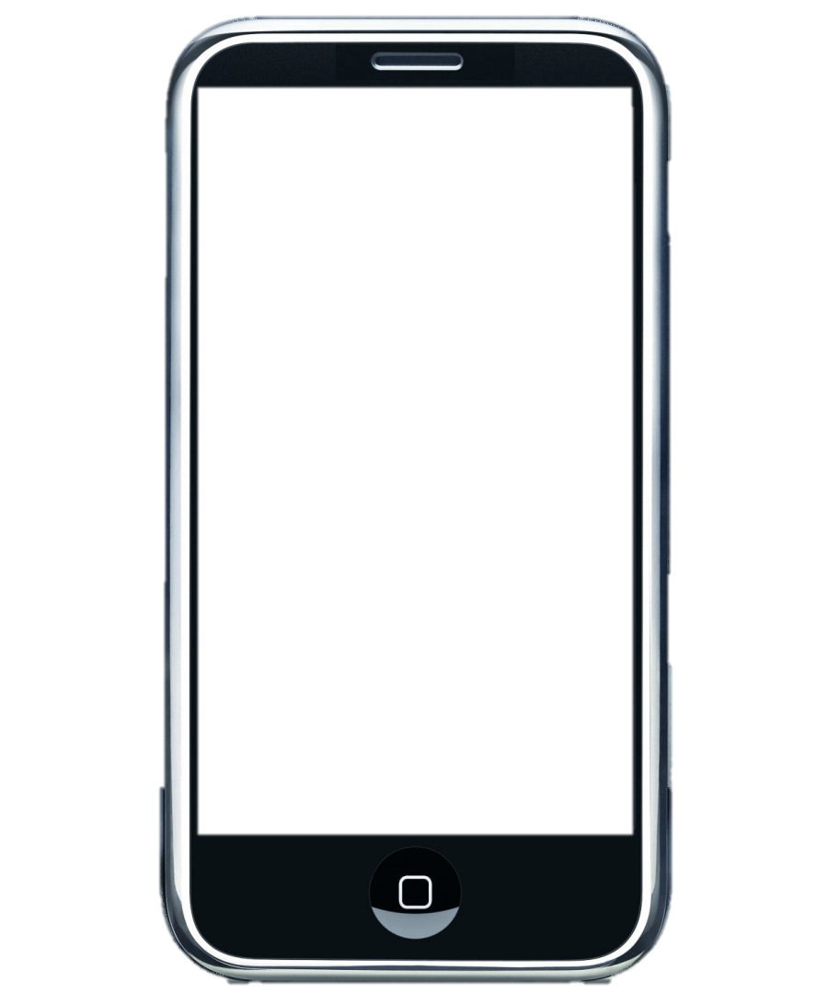
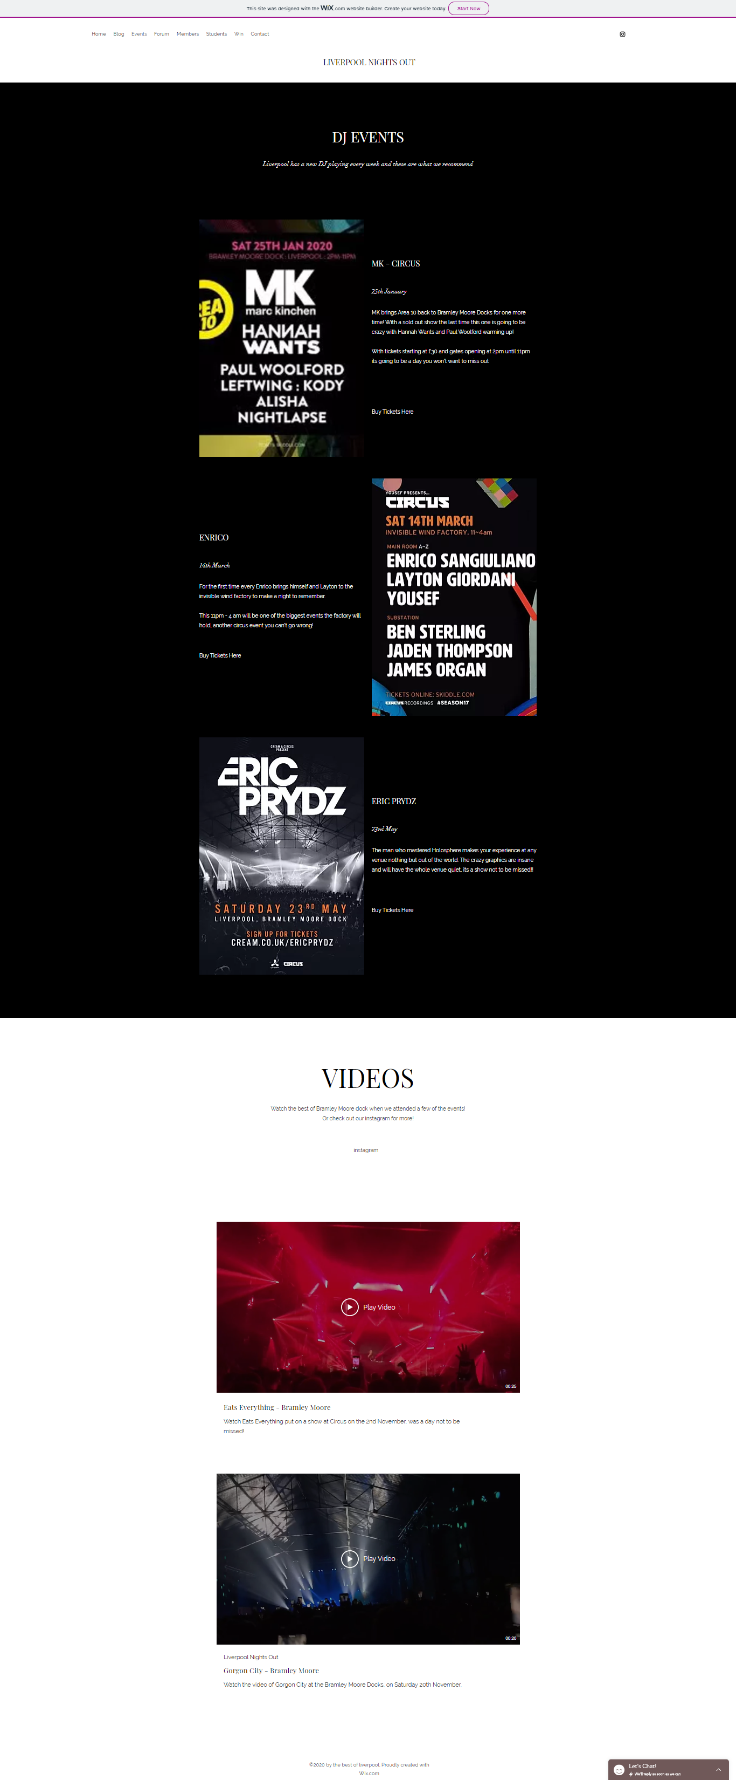

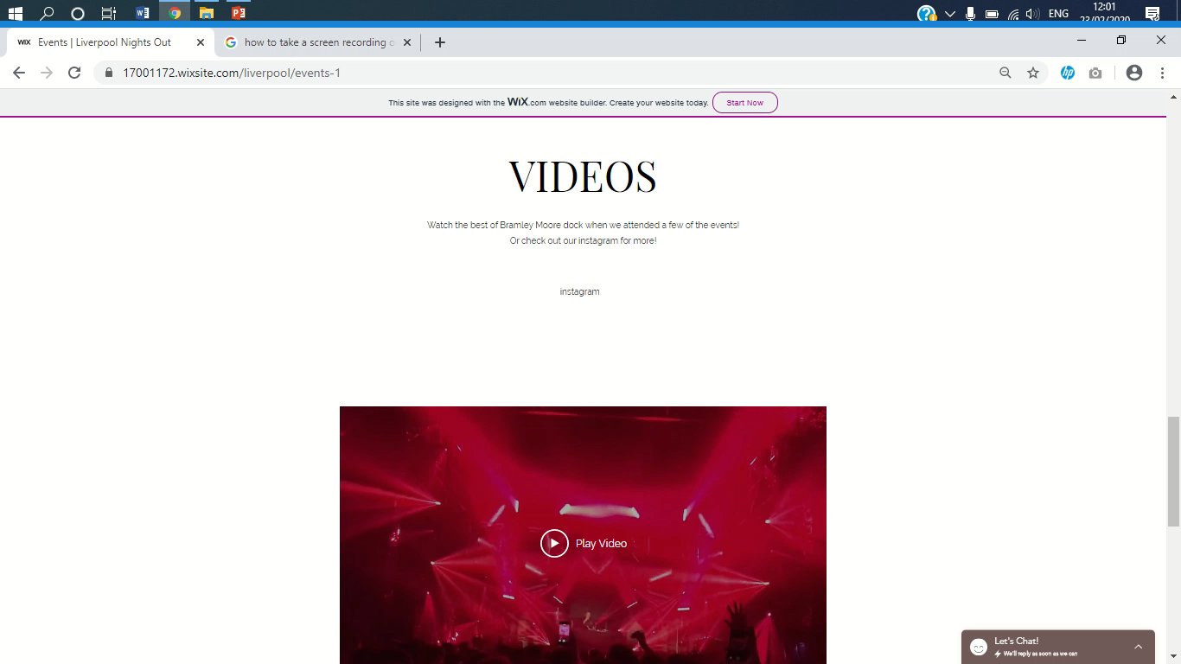
First half of page
Second half of page
Events page
Info on section
Link to social media
Videos of events
Event name
Date
Info on event
Buy tickets

Slide 5
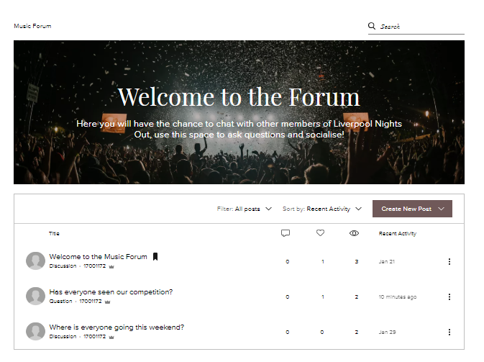
Forum
Searching for a particular post
Filter –
Questions or
Discussion
Posts can be created by anyone
Liking, commenting and post views

Slide 6
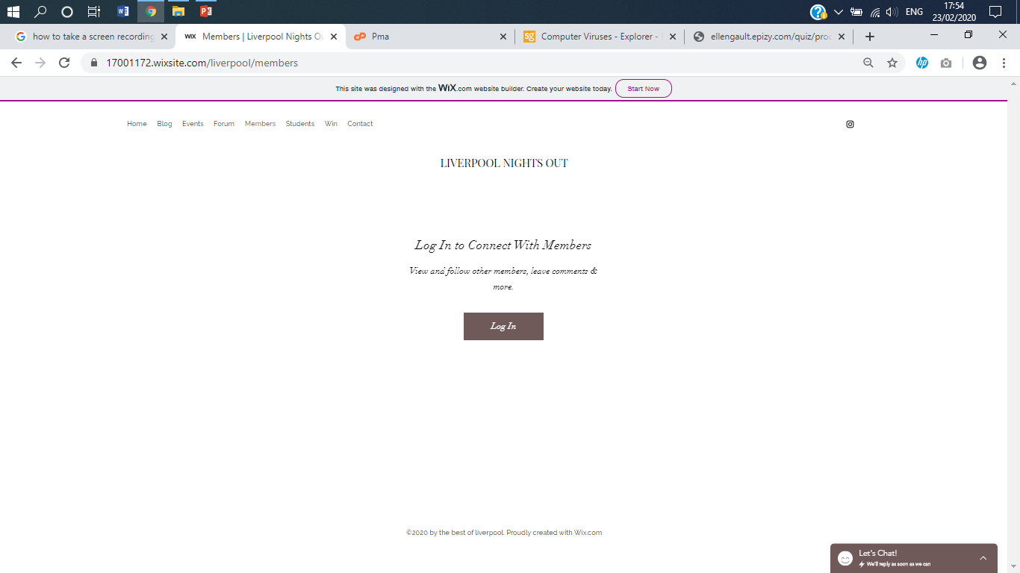
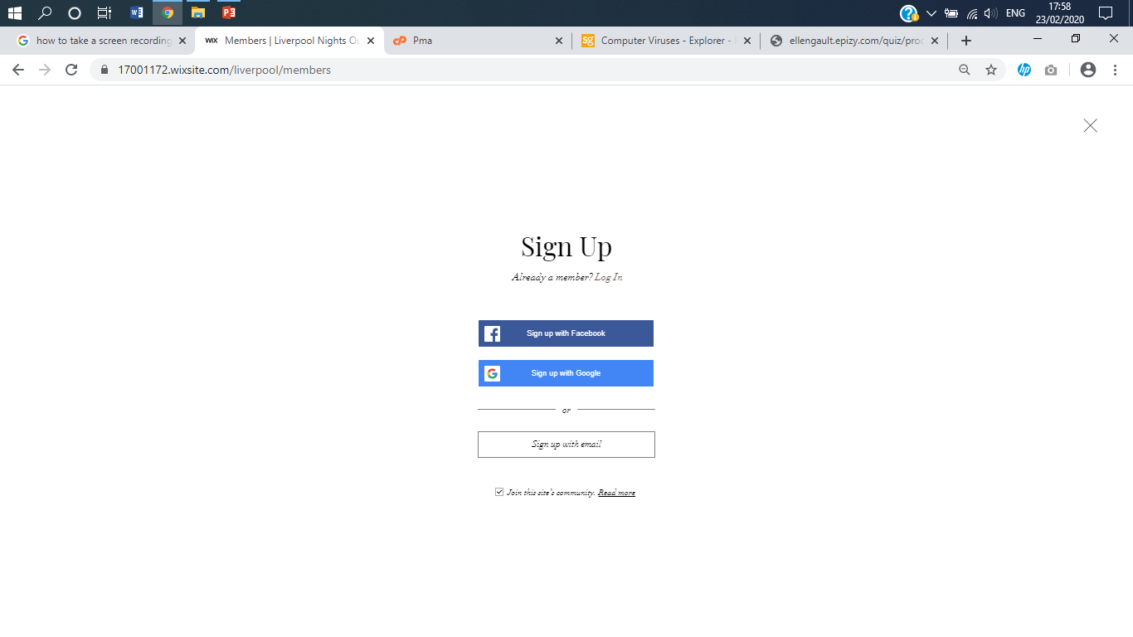
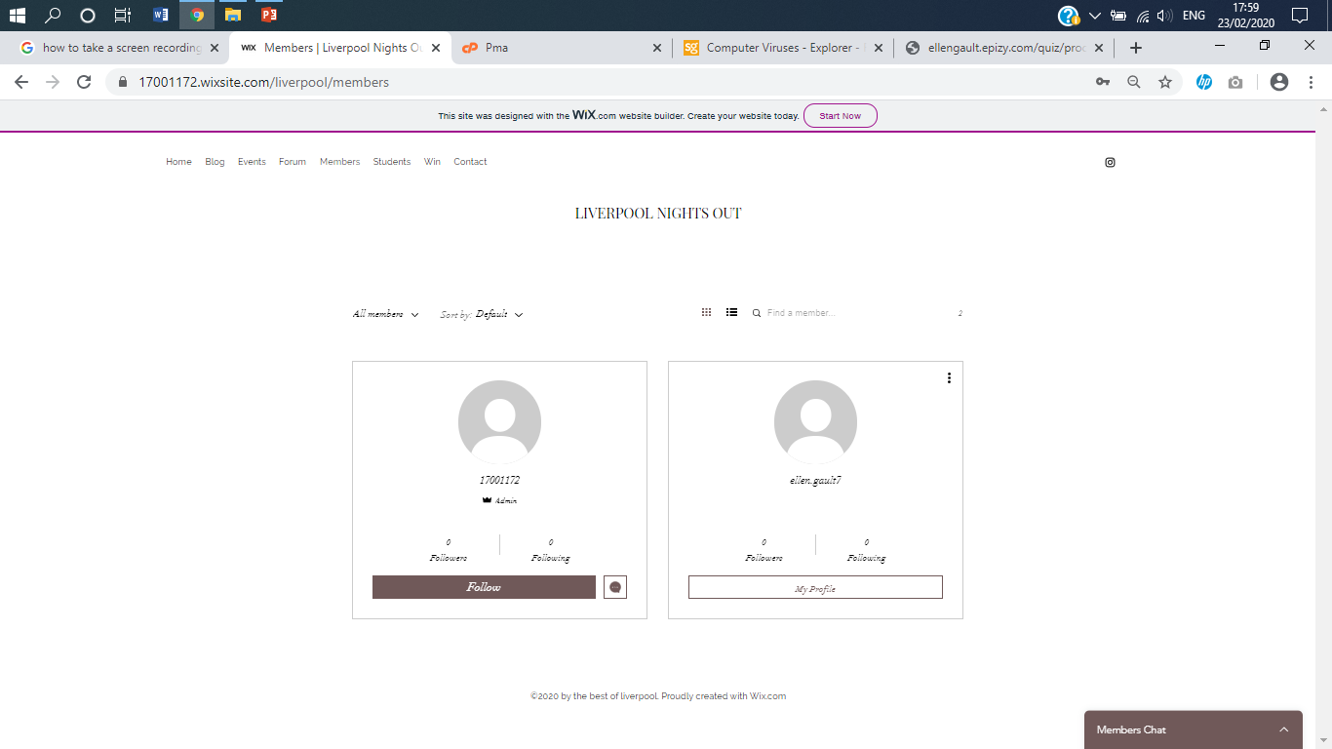
Members page
1
2
Features
Users have own profile
Can follow other members
Communicate and interact
Have info on their profile about their favourite places to go out at
Each profile gives details of:
Users name
Blog posts
Likes
Comments
Allows users to click other profiles and message other users directly
3

Slide 7
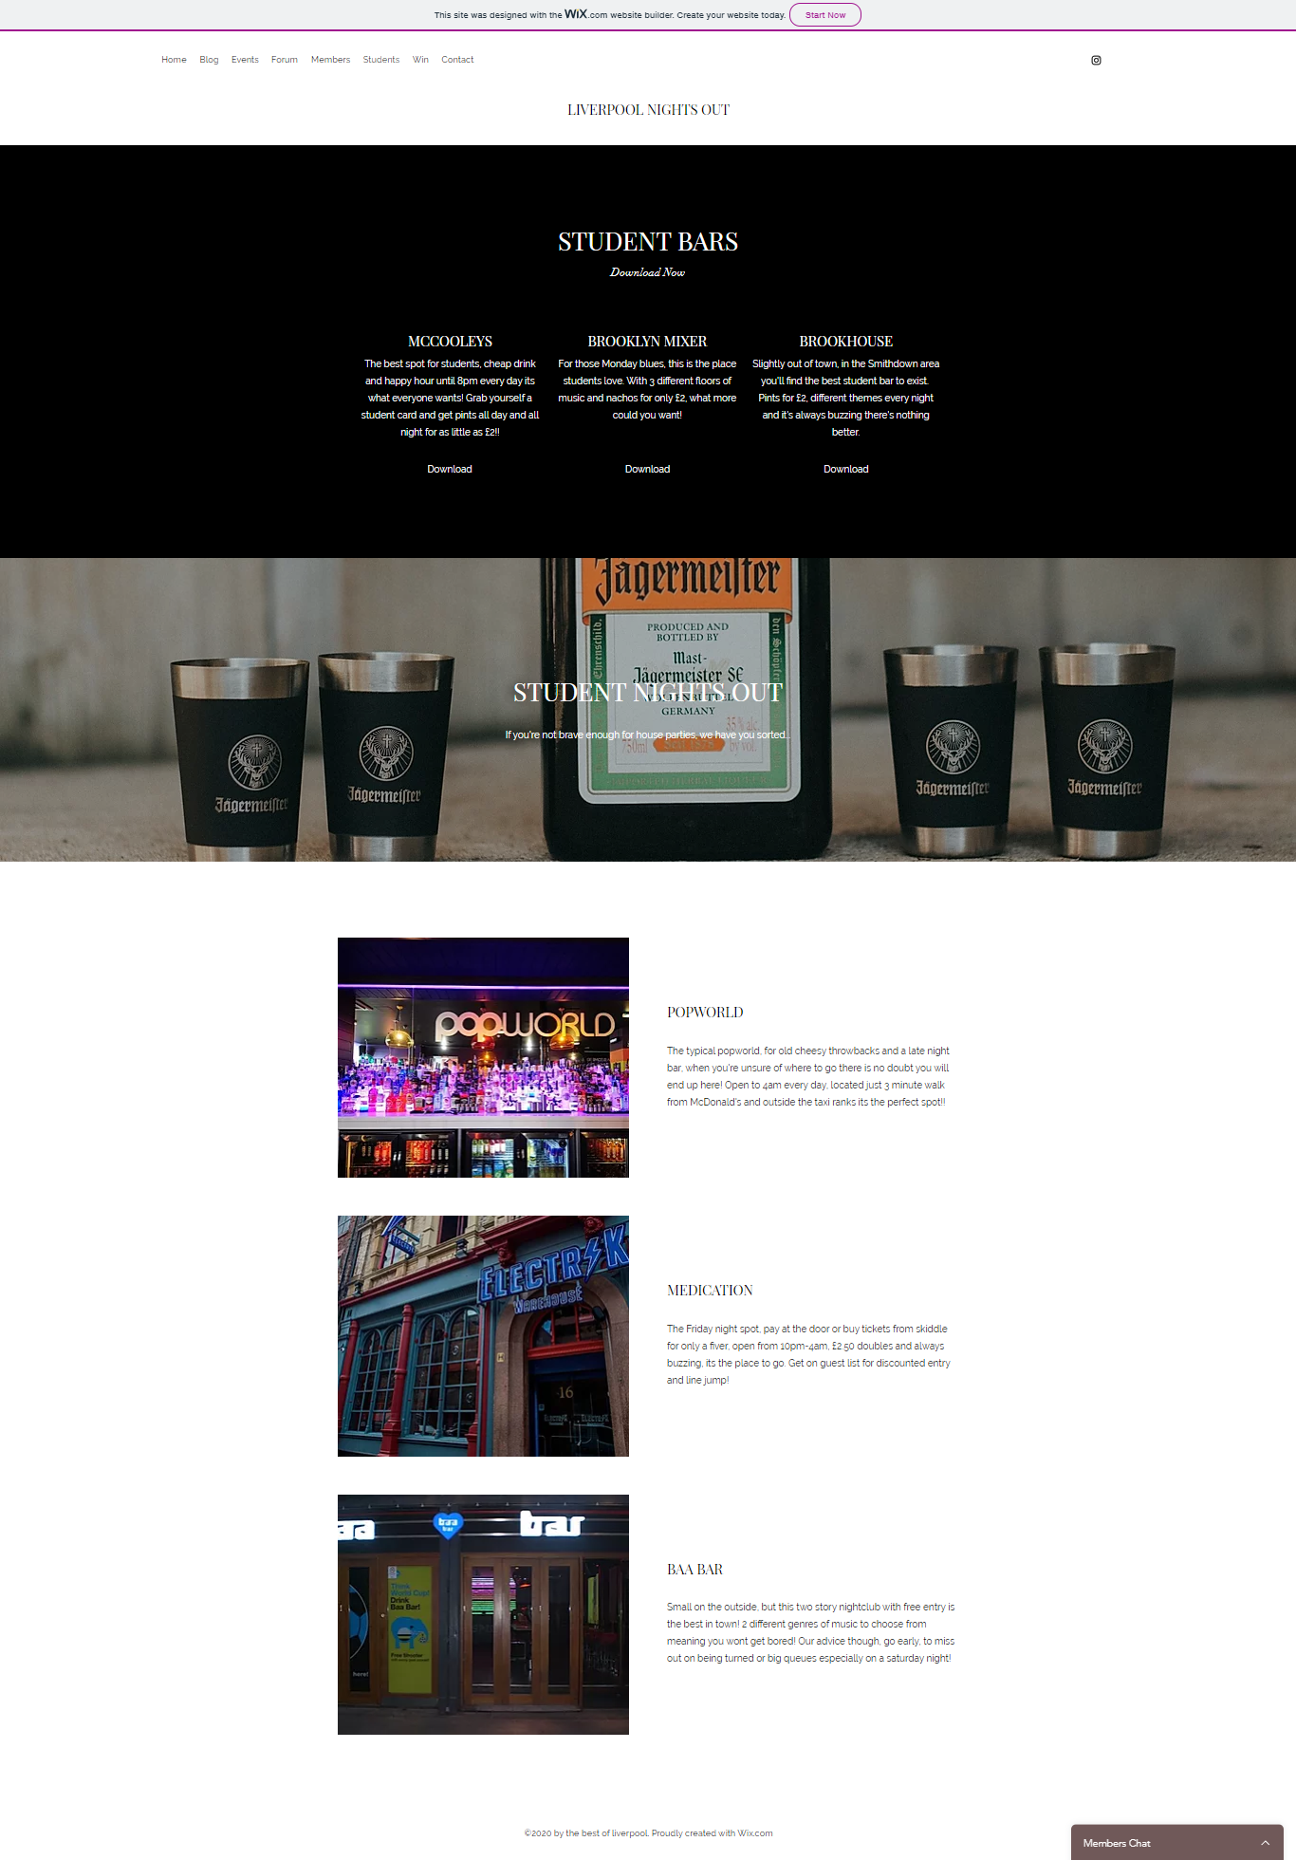
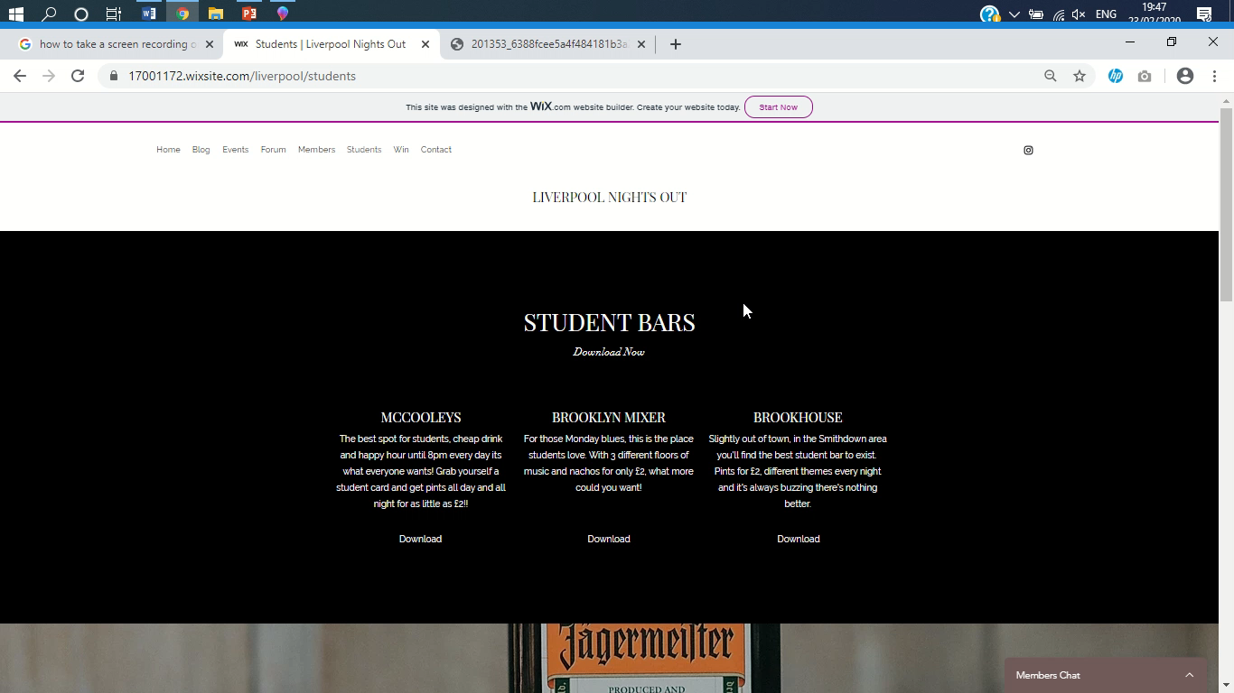
students page
Downloadable drinks menu
Cheapest bars
Cheapest nightclubs
Notes:
Why this page was included:
In Liverpool students tend to support the nightlife whether its clubs, bars or events , and has been known as one of the party cities for students, so it was only right to ensure that this website gave information to this group, whilst still including other groups to ensure the website was suitable for majority of ages. As the cocktails lovers section on the home page was clearly for older ages or for sophisticated and classy nights out, however it was extremely important to include a separate student section as they may be the possible dominate users of the site

Slide 8
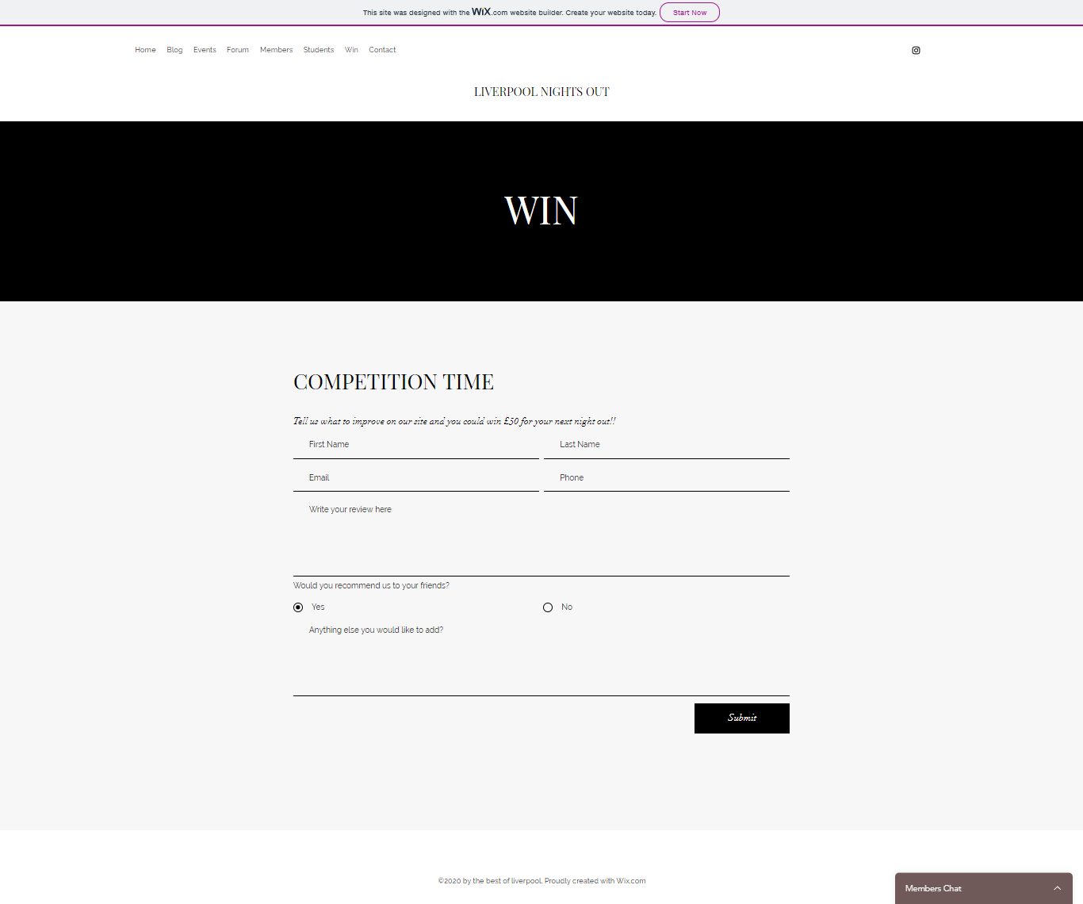
Win page
Way of getting feedback
Users gets entered into competition
Has chance to win
Full name
Contact details – email and phone
Users opinion
Recommend – yes or no
Anything else

Slide 9

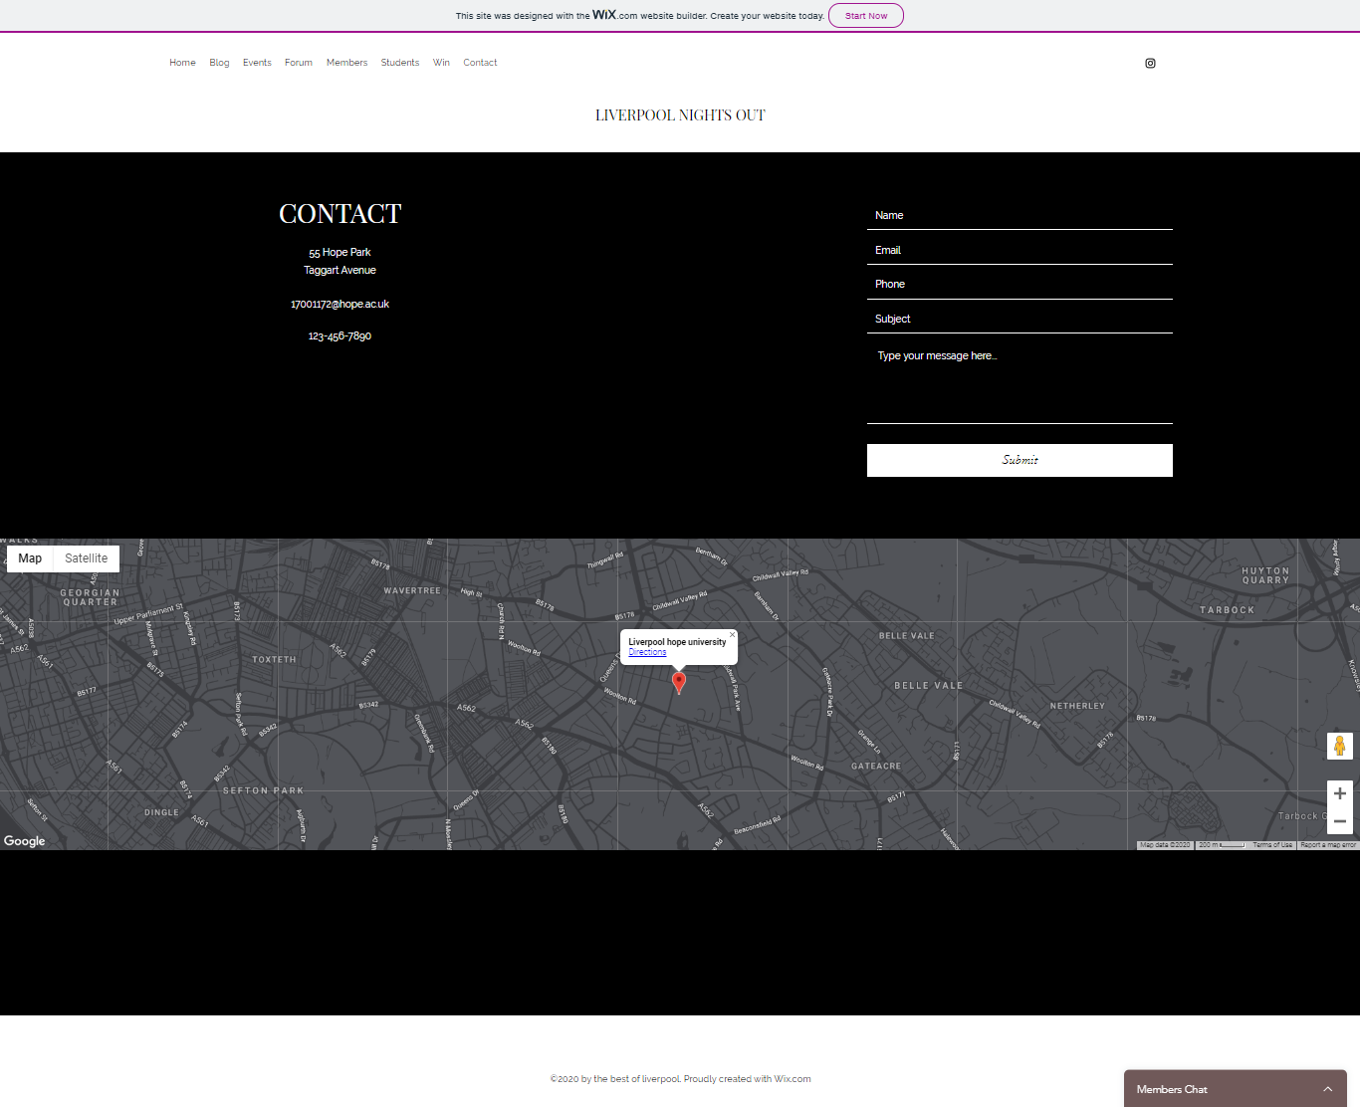
Contact page
Form for enquiries
Interactive map

Slide 10
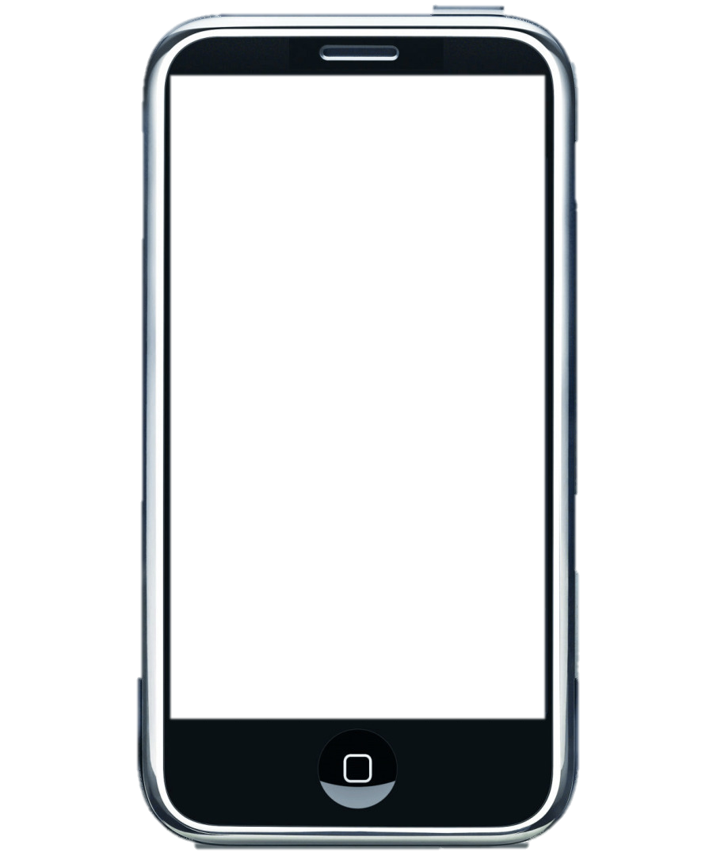
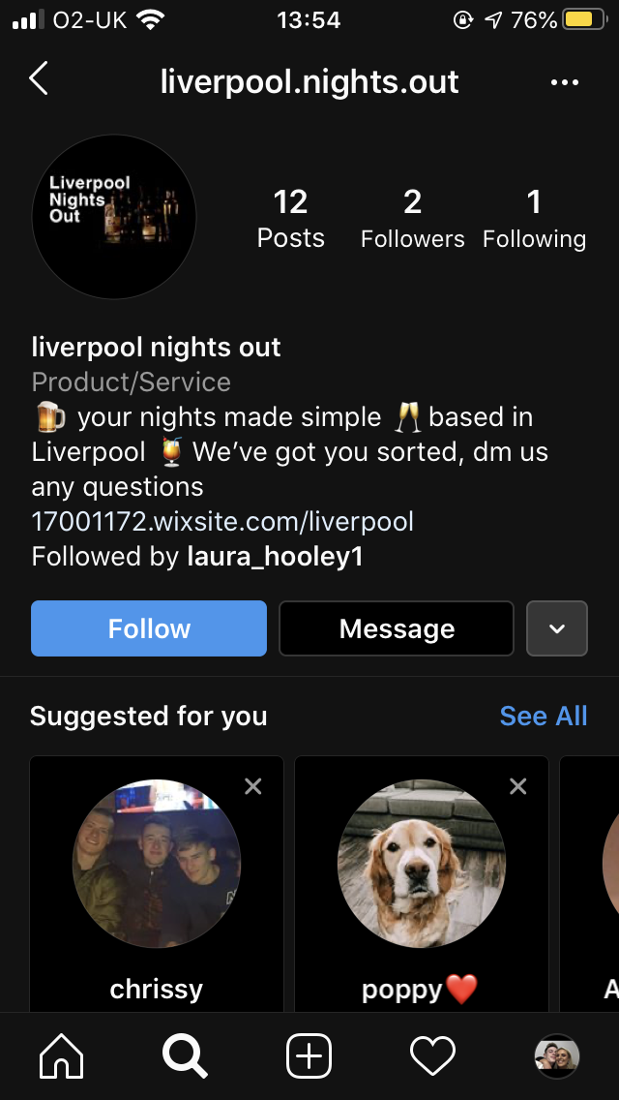
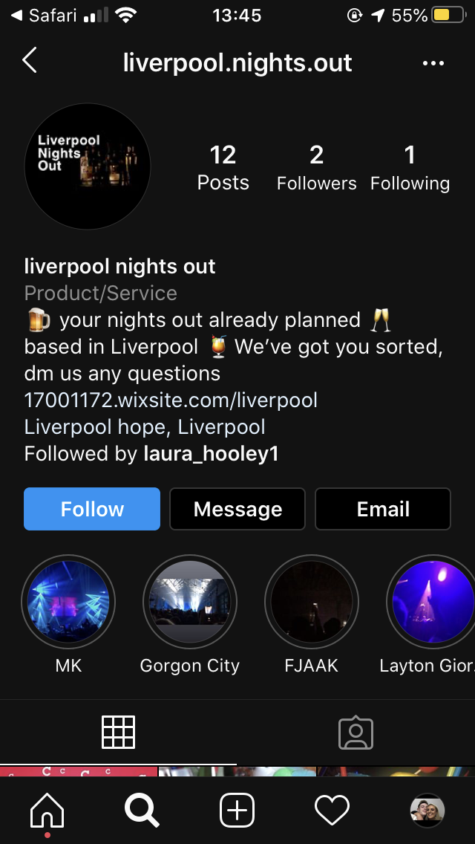
Instagram
Logo and stories
Link found throughout the website
https://www.instagram.com/liverpool.nights.out/
Website link
Why Instagram:
Suitable for clientele
Facebook and twitter wouldn’t be appropriate
Stories and highlights
Business profile option – direct contact links
29.9 million users
Highlights
Notes:
Say Instagram was used as the visual platform allows a personal connection with the end user, allowing them to get the full experience of different clubs and events through the use of pictures and videos, which encourages customers to interact and engage – by viewing videos, sharing with friends, commenting and liking.
The feed at a glance allows the users to see what the company is promoting as does the logo allows users to see what the account is for
This platform gives users another opportunity to ask questions privately through direct messaging
It allows promotion of the website with the link in the bio and using posts such as the competition boosts traffic to the website to enter the competition which increases the chance of them viewing the website
The use of hashtags makes it easier to reach other people
Reflection : a problem with using Instagram rather than facebook or twitter, on certain posts it talks about buying tickets and gives the link however it doesn’t hyperlink it meaning users have to type the link into a search engine themselves – the link in bio method can be used but for later posts the link will be changed
Unless the images or videos look intriguing users can skip pass them, whilst captions of images tend to be short so any lengthy captions will be skipped

Slide 11
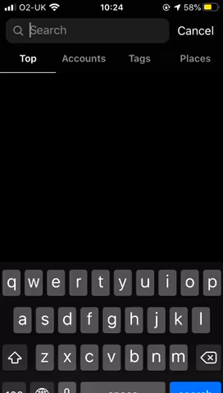
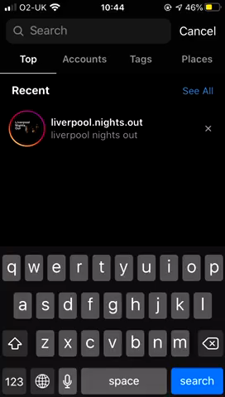
Instagram in action
Feed
Stories

